Slide 1

“MobileNet Neural Network skin disease detector with Raspberry pi Integrated to Telegram”
Batch Members :
N.SHANMUKHA SAI (21603107)
E.AARTHI (21603116)
Department of ECE
VISTAS
Supervisor:
DR.MADONA B. SAHAAI
Assistant professor
Department of ECE
VISTAS

Slide 2
Introduction and Problem statement
Introduction:
Focused on detecting Focused on detecting seven types of skin lesions using deep learning: Actinic Keratoses/Intraepithelial Carcinoma (AKIEC), Basal Cell Carcinoma (BCC), Benign Keratosis-like Lesions (BKL), Dermatofibroma (DF), Melanocytic Nevi (NV), Melanoma (MEL), Vascular Lesions (VASC)
Implementation using MobileNetV2 on Raspberry Pi 4 Model B.
Integration with Telegram chatbot for easy real-time interaction.
Enables fast, mobile-based skin disease detection.
Problem Statement:
Traditional diagnosis methods are time-consuming and dependent on manual evaluation.
Existing automated systems have lower classification accuracy.
Higher processing times impact real-time usability.
Need to improve accuracy and reduce output generation time through transfer learning techniques.

Slide 3
OBJECTIVES
To design a lightweight deep learning model for accurate classification of skin lesions in real-time.
To utilize transfer learning (MobileNetV2) for improved classification accuracy.
To enable real-time disease detection through Raspberry Pi and Telegram chatbot integration.
To reduce output generation time compared to existing systems.
To provide a user-friendly, mobile-accessible platform for quick diagnosis.
To ensure high reliability and efficient performance even with limited hardware resources.

Slide 4
Related Work
TITLE AND AUTHOR | EXPLANATION | ADVANTAGES | DISADVANTAGES
Global Cancer Statistics, by L.A.Torre, 2023 | The article shares global cancer data from GLOBOCAN 2020, reporting 19.3 million new cases and 10 million deaths in 2020. Breast cancer became the most diagnosed, while lung cancer caused the most deaths. Cancer rates are higher in developed countries, but death rates are worse in developing ones. By 2040, cancer cases are expected to rise by 47%, especially in developing countries. | Provides global cancer data and trends Highlights the need for better healthcare in developing countries | Some data are estimates, not actual reports Doesn’t assess treatment or prevention effectiveness

Slide 5
TITLE AND AUTHOR | EXPLANATION | ADVANTAGES | DISADVANTAGES
Melanoma detection by analysis of clinical images using convolutional neural network, by E. Nasr-Esfahani, 2024 | This paper uses Convolutional Neural Networks (CNNs) to detect melanoma (a type of skin cancer) from clinical images. The CNN automatically learns features from images to classify them as cancerous or not, aiming to improve early diagnosis. | Uses deep learning for automatic and accurate melanoma detection Reduces need for manual feature extraction | Needs a large dataset of labeled images for training May face issues with image quality or variation

Slide 6
Existing System vs Proposed System
Aspect | Existing System | Proposed System
Model Used | MobileNet CNN without transfer learning | MobileNetV2 with transfer learning for improved classification
Accuracy | Moderate classification accuracy | Higher accuracy through fine-tuning and optimized model training
Response Time | Slower prediction due to unoptimized model deployment | Faster output generation (~2–3 seconds)
User Interaction | Basic Telegram bot for image submission and result | Same Interaction with confidence score feature

Slide 7


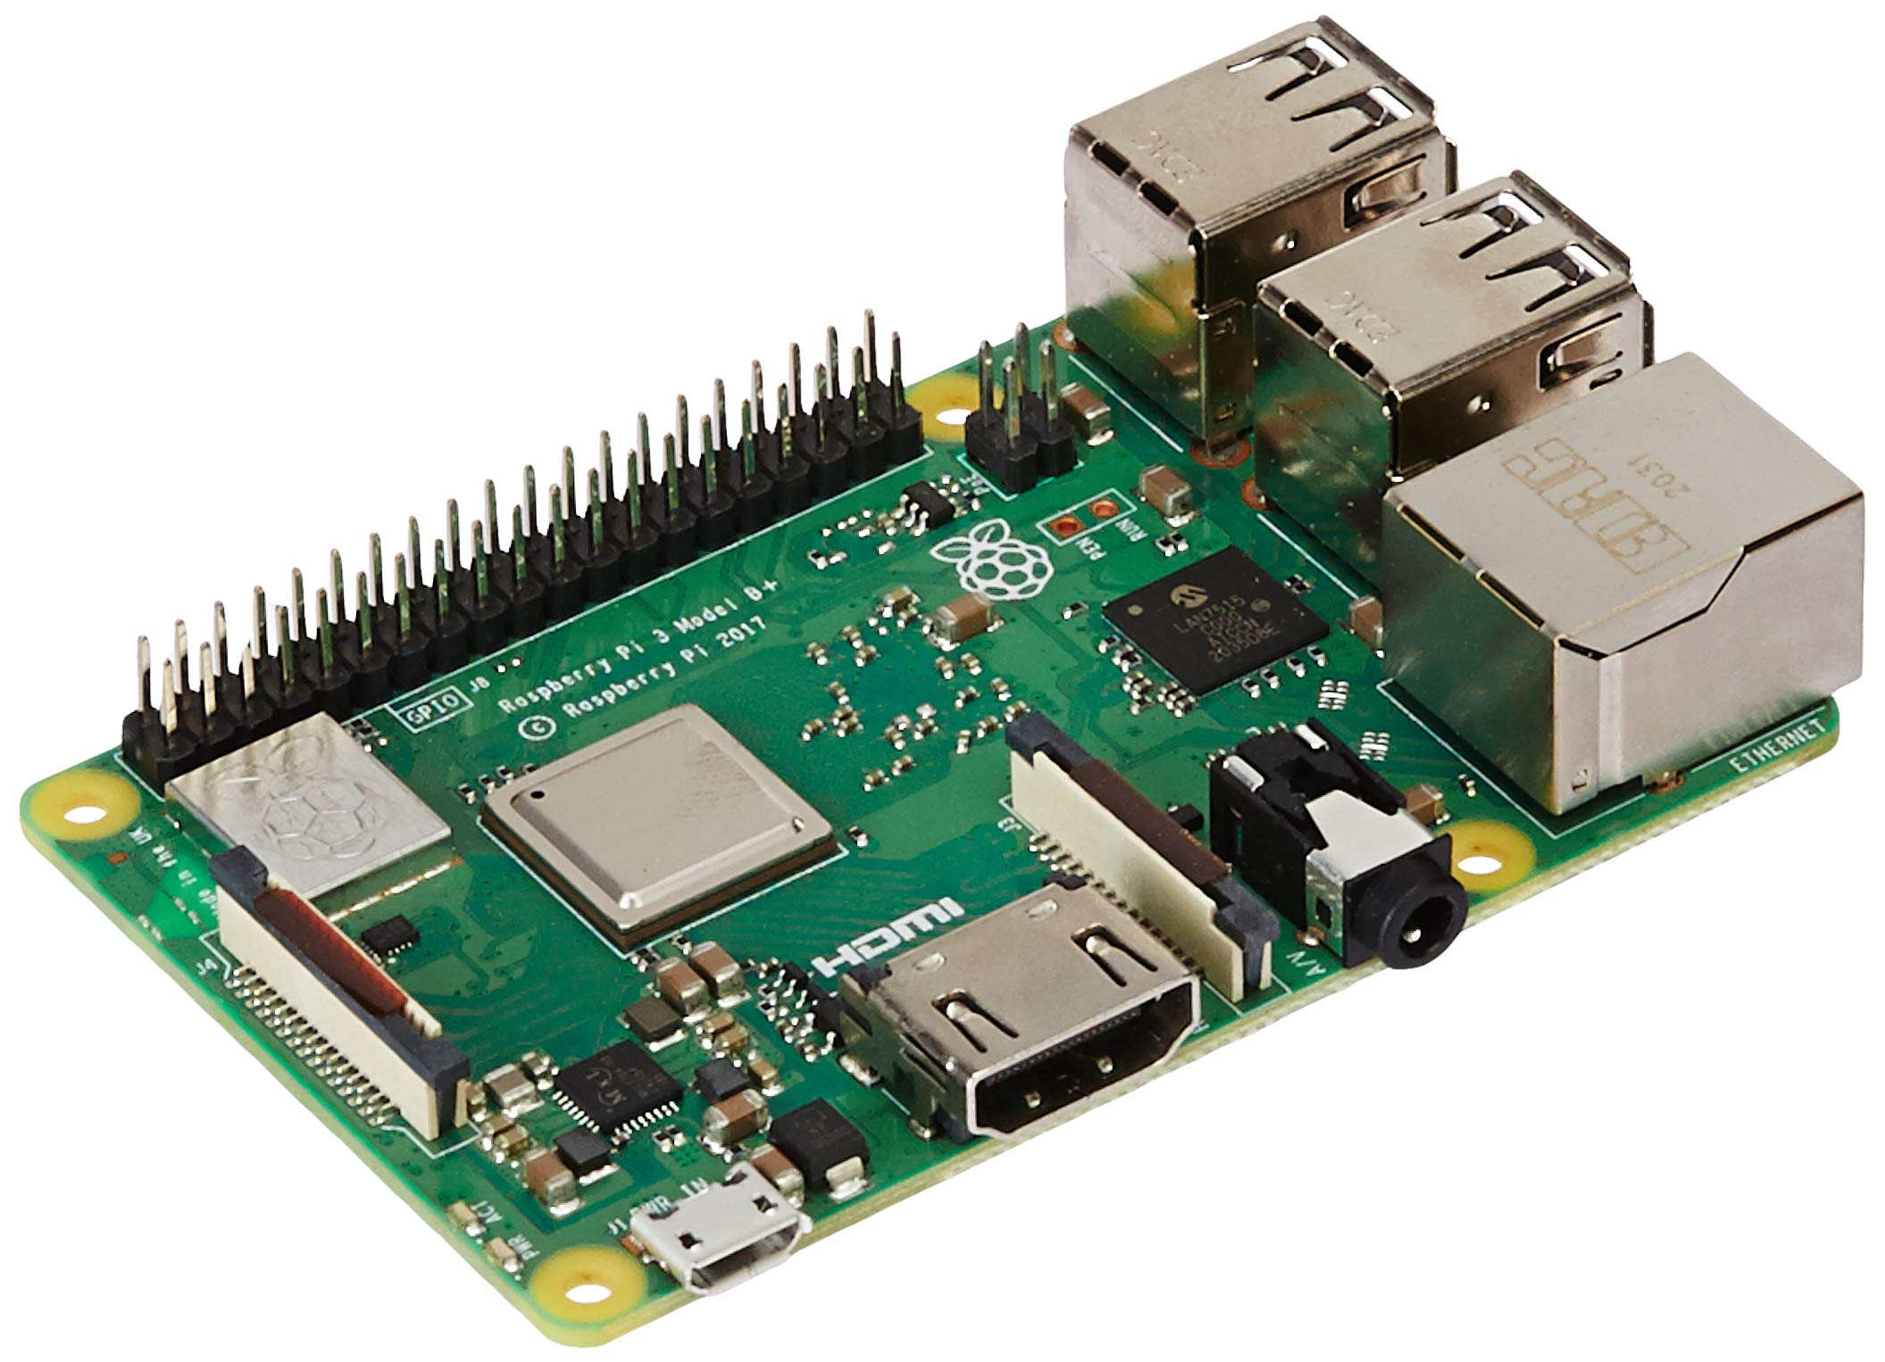
Telegram Bot Integration
Steps Followed:
Accessed @BotFather on Telegram.
Created a new bot by giving it a unique name and username.
Note: Only the username is searchable by users.
Received a unique API token (Bot Token) from BotFather.
Used this token in Python code to establish a secure connection between the Raspberry Pi and the Telegram bot.
Set bot name and user name
Include the API token in code to establish Connection
@Botfather
Access API token
Chatbot Raspberry pi

Slide 8
BLOCK DIAGRAM
User uploads an image → (via Telegram Bot)
Image received by Raspberry Pi → (via Python Telegram Bot library)
Image processed by MobileNetV2 → (deployed on Raspberry Pi)
Result sent back to Telegram Bot → (via Python Telegram Bot library)
Prediction result generated → (disease name + confidence score)
Disease prediction performed → (using trained MobileNetV2 model)
User receives the prediction on Telegram

Slide 9
Hardware and Software Requirements
Hardware:
Raspberry Pi 4 Model B
4 GB RAM
Quad-core ARM Cortex-A72 Processor
MicroSD Card (32GB or more) – for OS and storage
Smartphone
Software:
Raspberry Pi OS / Ubuntu – lightweight OS to run scripts
Python – core programming language
TensorFlow – for running MobileNet model
OpenCV – for image preprocessing
Python Telegram Bot Library – to integrate with Telegram API

Slide 10
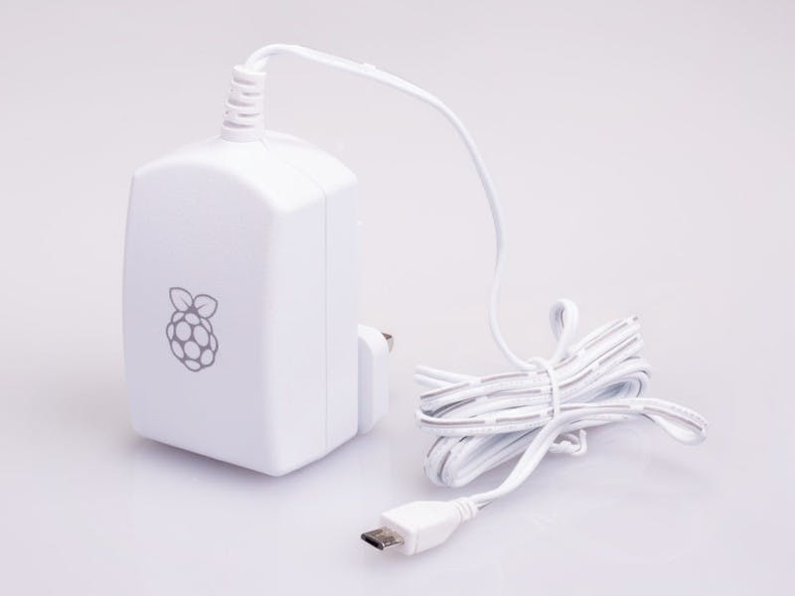
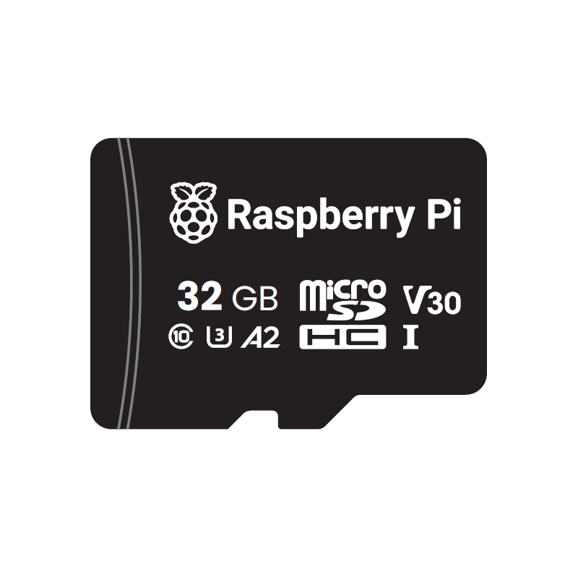
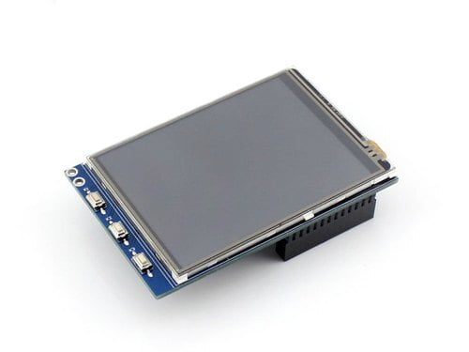

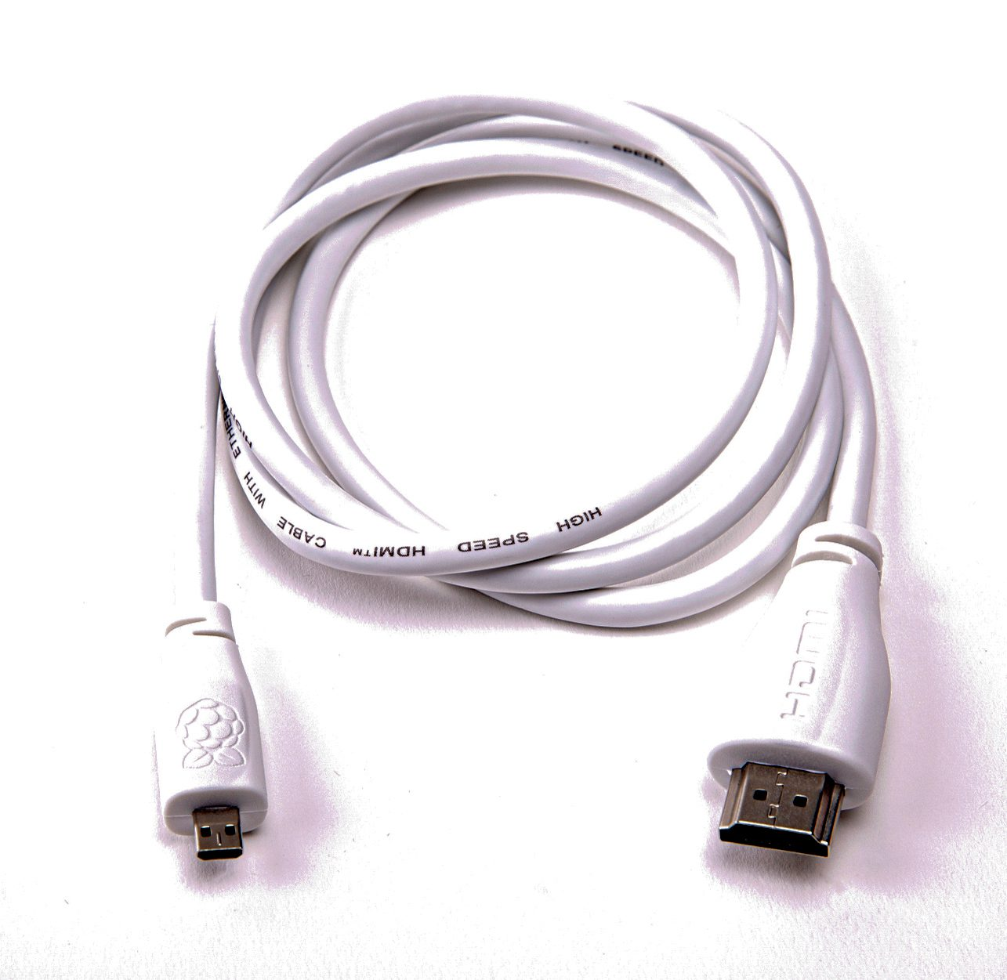
Apparatus
Power Supply for Raspberry pi
Raspberry pi
SD card for storage
HDMI cable
Display
A Mobile phone with Telegram Application

Slide 11
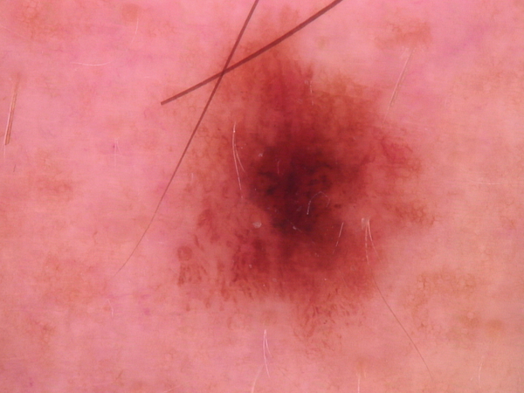
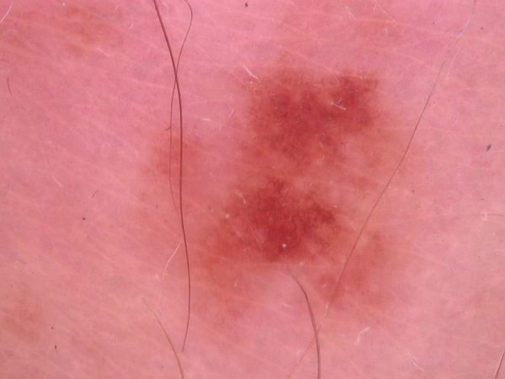
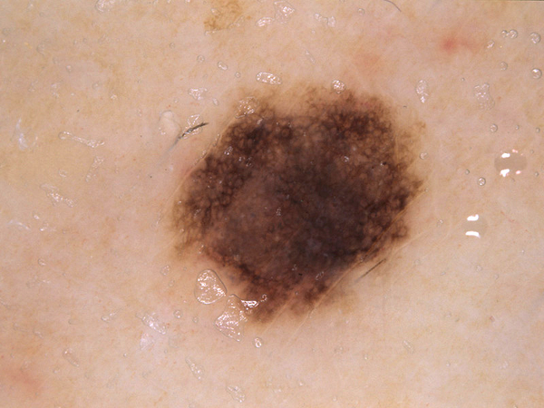
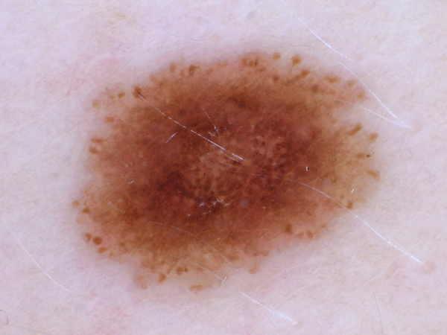
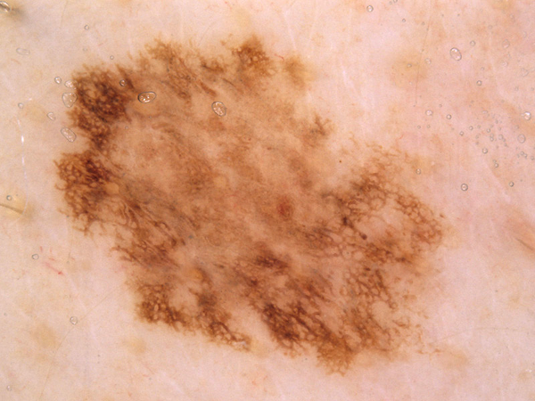
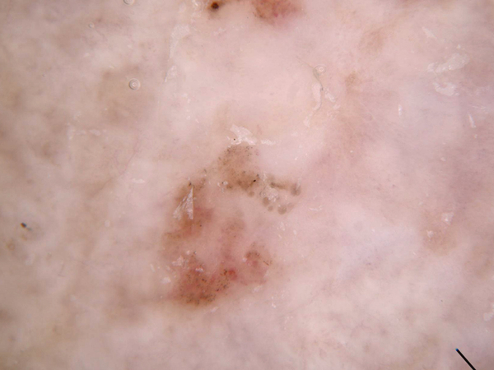
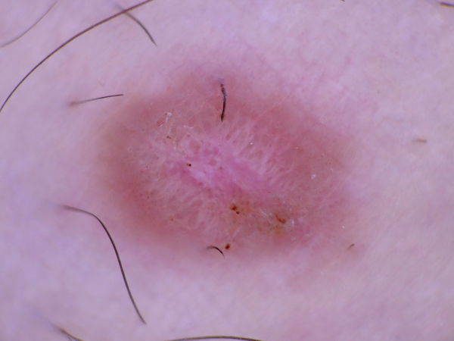
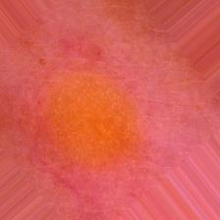
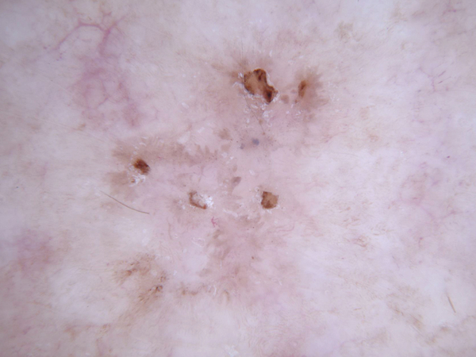
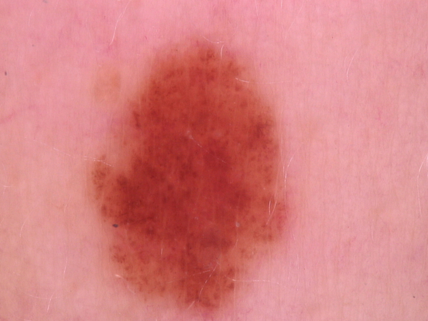
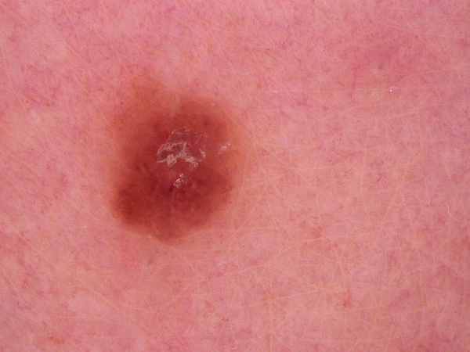
Dataset sample Images
Sample clinical images of Actinic Keratosis/Intraepetheliel Carcinoma (AKIEC) and Basal Cell Carcinoma (BCC) lesions from the HAM10000 dataset hosted on kaggle

Slide 12
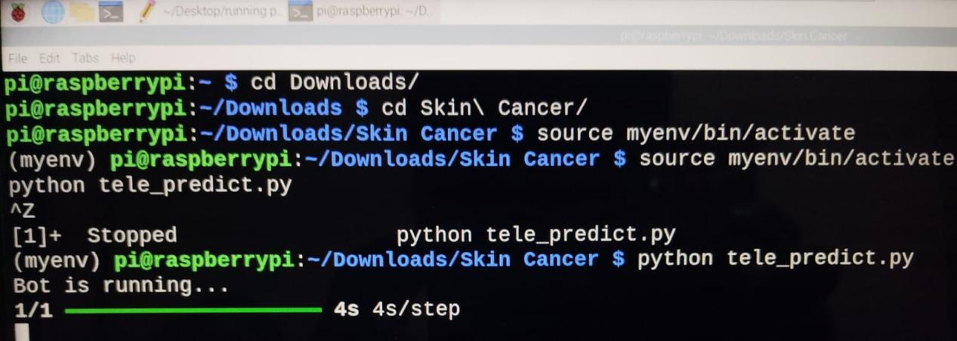
RESULTS AND DISCUSSION
Bot Execution on Raspberry Pi
The bot script was executed in a virtual environment (myenv) on Raspberry Pi.
The bot successfully started, displaying "Bot is running...".
The execution process is visible in the terminal, confirming the bot is active.

Slide 13
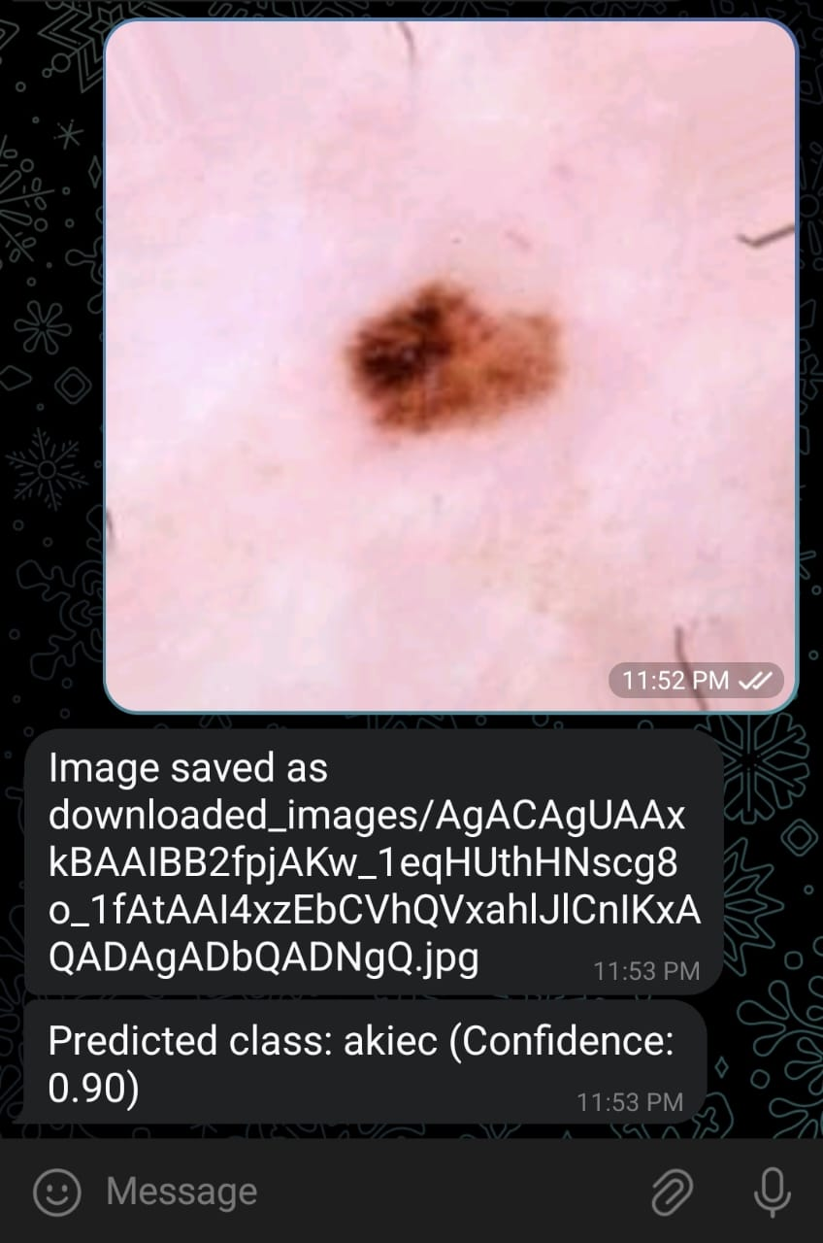
Predicted Output
Real-time Skin Disease Detection using Telegram Bot – The system processes an image, predicts the disease (BCC or AKIEC), and returns the classification result along with confidence score, making diagnosis quick and accessible.

Slide 14
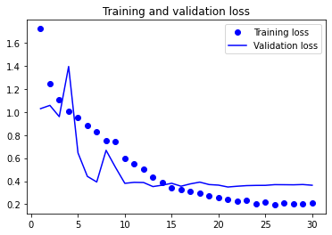
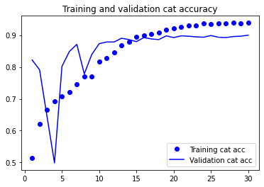
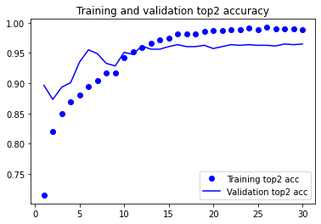
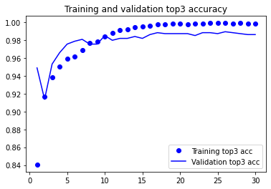
Training and Validation results of proposed system
Accuracy
Accuracy
No. of epochs
No. of epochs
Accuracy
Accuracy
No. of epochs
No. of epochs
No. of Epoch | Training Top-2 Accuracy (%) | Training Top-3 Accuracy (%) | Training Loss (%)
1 | 85 | 86 | 1.8
2 | 88 | 93 | 1.0
3 | 90 | 95 | 0.8

Slide 15
Conclusion
Successfully developed a system to detect seven skin diseases
Used MobileNetV2 with transfer learning for improved accuracy.
Deployed on Raspberry Pi 4 for lightweight and real-time predictions.
Integrated with Telegram Bot for fast and user-friendly interaction.
Achieved better performance than the existing system in terms of accuracy and response time.

Slide 16
REFERENCES
[1] L. A. Torre, F. Bray, R. L. Siegel, J. Ferlay, J. L.-Tieulent, and A. Jemal, "Global cancer statistics, 2012," CA: A Cancer Journal for Clinicians, vol. 65, no. 2, pp. 87-108, 2015.
[2] E. Nasr-Esfahani, S. Samavi, N. Karimi, S. M. R. Soroushmehr, M. H. Jafari, K. Ward, and K. Najarian, "Melanoma detection by analysis of clinical images using convolutional neural network," in Proc. 38th Annu. Int. Conf. IEEE Eng. Med. Biol. Soc. (EMBC), 2016, pp. 1373-1376.
[3] J. Rathod, V. Wazhmode, A. Sodha, and P. Bhavathankar, "Diagnosis of skin diseases using convolutional neural networks," in Proc. 2nd Int. Conf. Electron. Commun. Aerosp. Technol. (ICECA), 2018, pp. 1048-1051.
[4] A. Candra, Y. Kurniawan, and K. H. Rhee, "Security analysis testing for secure instant messaging in Android with study case: Telegram," in Proc. 6th Int. Conf. Syst. Eng. Technol. (ICSET), 2016, pp. 92-96.
[5] G. Schaefer, R. Tait, and S. Y. Zhu, "Overlay of thermal and visual medical images using skin detection and image registration," in Proc. Int. Conf. IEEE Eng. Med. Biol. Soc., 2006, pp. 965-967.

Slide 17
REFERENCES Contd…
[6] C. L. Aruta, C. R. Calaguas, J. K. Gameng, M. V. Prudentino, A. Anthony, and C. J. Lubaton, "Mobile-based medical assistance for diagnosing different types of skin diseases using case-based reasoning with image processing," Int. J. Comput. Intell., vol. 3, 2015.
[7] A. A. L. C. Amarathunga, E. P. W. C. Ellawala, G. N. Abeysekara, and C. R. J. Amairaj, "Expert system for diagnosis of skin diseases," Int. J. Sci. Technol. Res., vol. 4, no. 1, pp. 174-178, 2015.
[8] O. B. Akinrinade, P. A. Owolawi, C. Tu, and T. Mapayi, "Graph-cuts technique for melanoma segmentation over different color spaces," in Proc. Int. Conf. Intell. Innov. Comput. Appl. (ICONIC), 2018, pp. 1-5.
[9] P. Tschandl, C. Rosendahl, and H. Kittler, "The HAM10000 dataset, a large collection of multi-source dermatoscopic images of common pigmented skin lesions," Sci. Data, vol. 5, no. 180161, 2018.
[10] D. B. Mendes and N. C. Silva, "Skin lesions classification using convolutional neural networks in clinical images," arXiv preprint, arXiv:1812.02316, 2018.

Slide 18
THANK YOU

